Slide 1

DATA VISUALIZATION USING PYTHON
Project Guide :Mr. S. Dhamodaran
Name of the Student: PATIBANDLA VENKATA LOHITH KUMAR
Register Number: 39111135

Slide 2
Presentation Outline
Course Certificate
Introduction
Objectives
Module Implementation
Application Snapshots
Results and Discussions
Conclusion & Future work
References

Slide 3
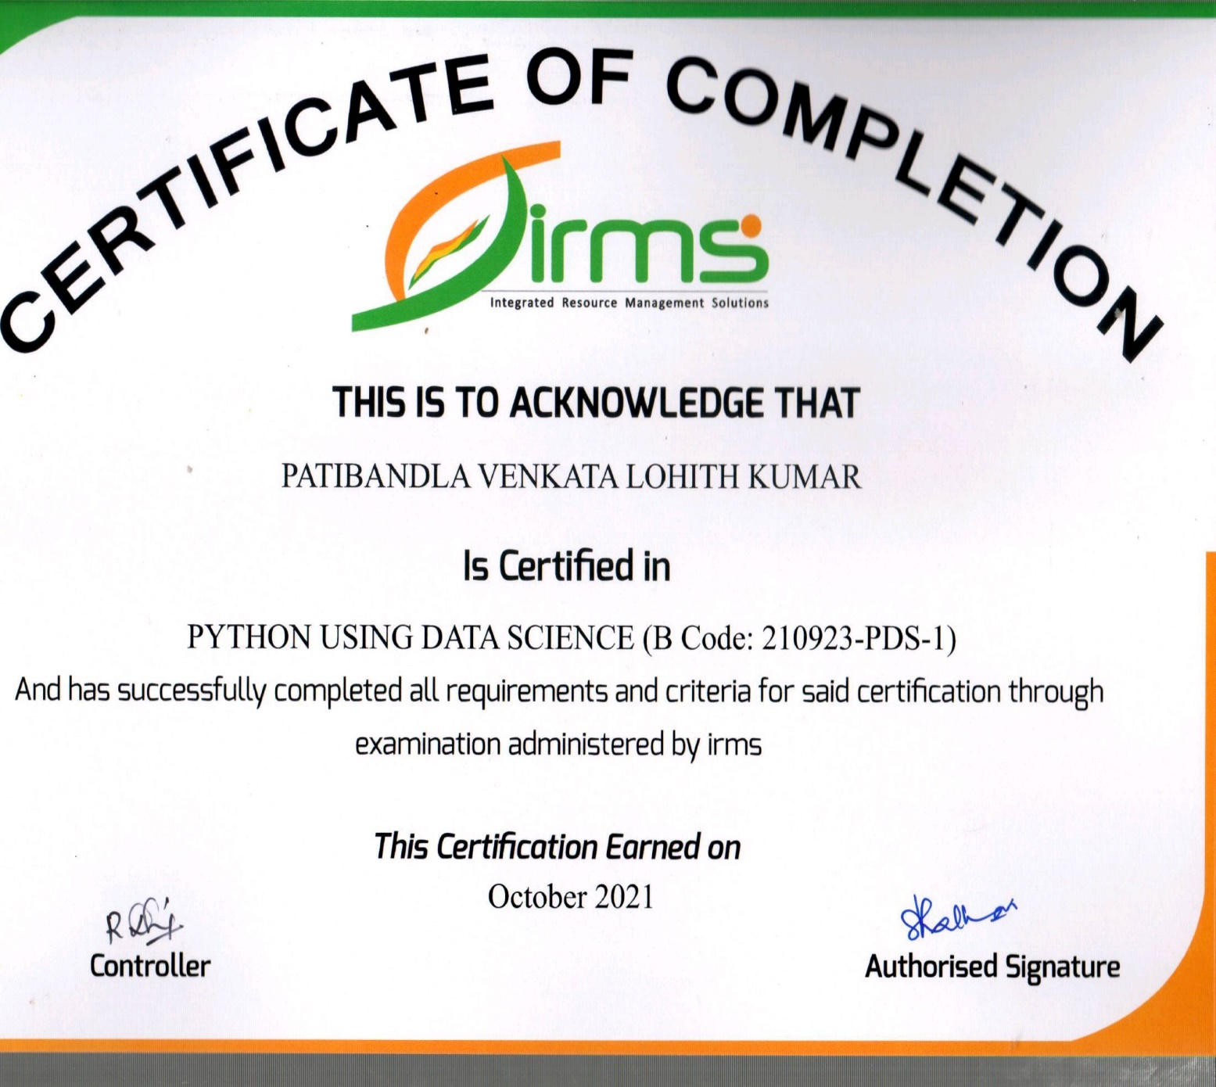
Course Certificate

Slide 4
Introduction
Data Visualization is the discipline of trying to understand data by placing it in a visual Context so that pattern, trends and correlations that might not otherwise be detected can be exposed.
Python offers multiple great graphing libraries that come packed with lots of different features. No matter if you want to create interactive, live or highly customized plots python has an excellent library for you.
In data visualization the program is designed in such a that user can analyze .csv or .tsv files for analysis.
Using Data visualization technique we are going to analyze a .csv which contains match details of ONE DAY INTERNATIONAL league.

Slide 5
Problem Statement
Understand the attributes of a dataset and visualize the output as per rows and columns and print the graphs from each data frame generated from the data set and undergo the data cleaning process.

Slide 6
Objectives
The main goal of this data visualization objective is to visualize the dataset in different formats using python.
In this project I am going to use a data set which contains data of ONE DAY INTERNATIONAL matches history from last 35 years For a better understanding and visualization I am going to compare the performance between two teams INDIA and PAKISTAN.
In this project Iam going to import packages from python like Matplotlib, Seaborn, plotly, NumPy and Pandas. Using these modules we can print and generate graphs like bar, pie, scatter.

Slide 7
Project Implementation
In this project we are going to implement python modules for visualizing the data from the dataset.
Matplotlib, Plotly, Pandas, Numpy, Seaborn are the modules which are imported in this project.
Matplotlib : Matplotlib is the most popular python plotting library. It is a low-level library with a Matlab like interface which offers lots of freedom at the cost of having to write more code.
Plotly : It allows users to import, copy and paste, or stream data to be analyzed and visualized.
Pandas : It is an open-source Python Library providing high-performance data manipulation and analysis tool using its powerful data structures.
Seaborn : It is a Python data visualization library based on Matplotlib. It provides a high-level interface for creating attractive graphs.

Slide 8
Hardware requirements:
Computer or pc with latest processor.
Ram: 2gb
Software requirements:
Jupyter Notebook(Anaconda 3)
Python installed in system
Modules installed from python.
To start this project we need a dataset from kaggle or any other dataset providers. Datasets look like .csv files. These datasets contain the information about the data we need.
In order to visualize the data I took a dataset from kaggle website which contains data related ONE DAY INTERNATIONAL cricket matches results from past 35years.
We have to upload this file in Jupyter after importing the modules.

Slide 9
The analysis in this project shows the results of each and every match played from past 35 years. To explain and simply it more briefly I had compared to teams INDIA and PAKISTAN matches and visualized their performances and analyzed the data set.
After analyzing the dataset the we are going to get the outputs inform of graphs and pie charts.

Slide 10
Methodology
The dataset will be imported and we have to perform data cleaning and read the data frames to visualize the data inform of tables, doing this will make us to understand the data from the dataset in an easy way.
We need Python in Jupyter notebook to import the modules and we can count the values form the dataset to visualize the data from dataset.
I had used countplot technique to count the values from data and plot the graph, and stripplot techniques to plot the graph in scatter graph.

Slide 11
The xticks is a function rotation techniques which will mention the data to rotate the date ticks on the x axis by a specified amount of degrees.
We can use the savefig method to save the plotted graphs to our files.
Mean() function can be used to calculate mean/average of a given list of numbers. It returns mean of the data set passed as parameters.
Figsize can be used to present the graph in a particular size we need.

Slide 12
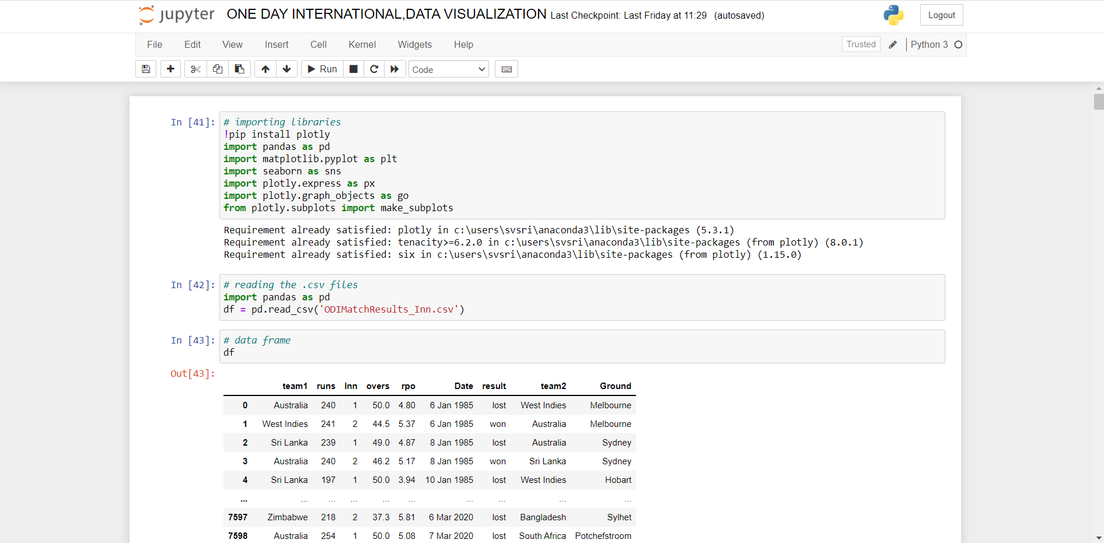
Application Snapshots
Jupyter Interface

Slide 13
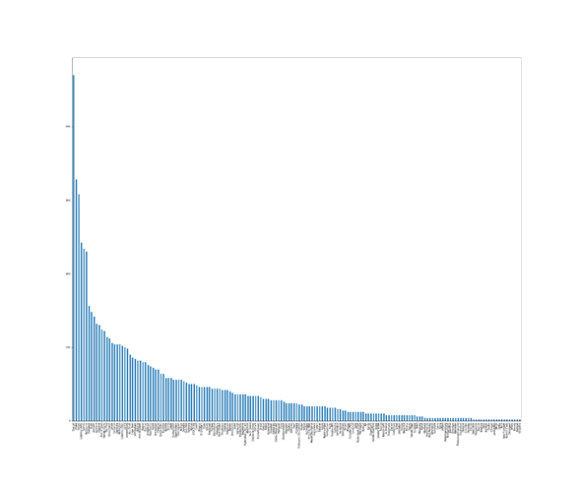
Result
Graph on ground values

Slide 14
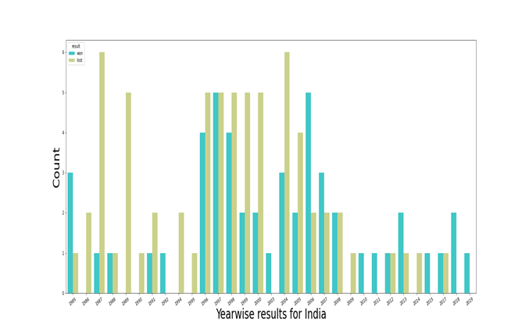

Slide 15
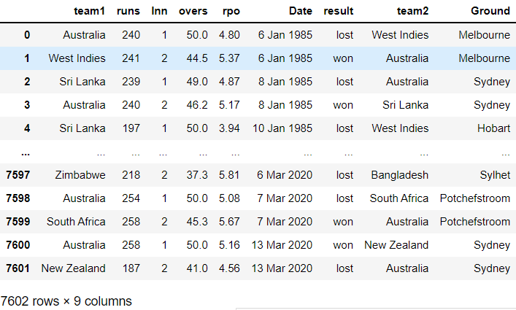
Data frame of all the teams

Slide 16
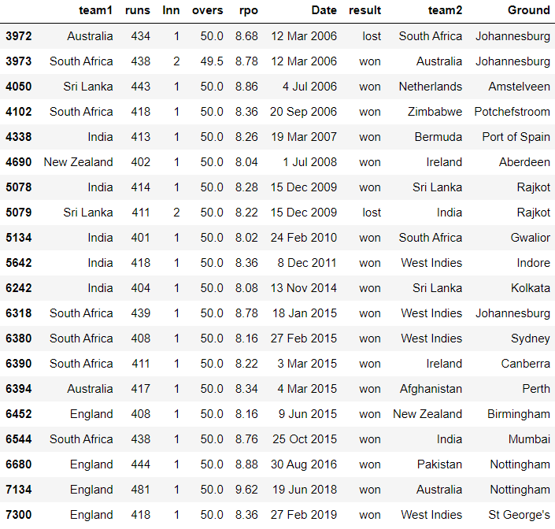
Data frame table on Scores of each team

Slide 17
Conclusion
From this project we can conclude that all the different type of visualizations are shown through Python techniques.
We have illustrated the .csv file which contains the data of ODI cricket matches that are played from past 35years in different forms of graphs and visualizations.
We can use any type of data set and even .tsv files to data visualize the information in the formats we like using Python.

Slide 18
References
[1] | Kaggle website for dataset https://www.kaggle.com/palashiitk/cricket-odi-results
[2] | Python to import the modules.

